Slide 1
Accessibility on the Library Horizon
The NMC Horizon Report > 2017 Library Edition
http://bit.ly/ACRL2017Horizon #ACRL2017Horizon

Slide 2
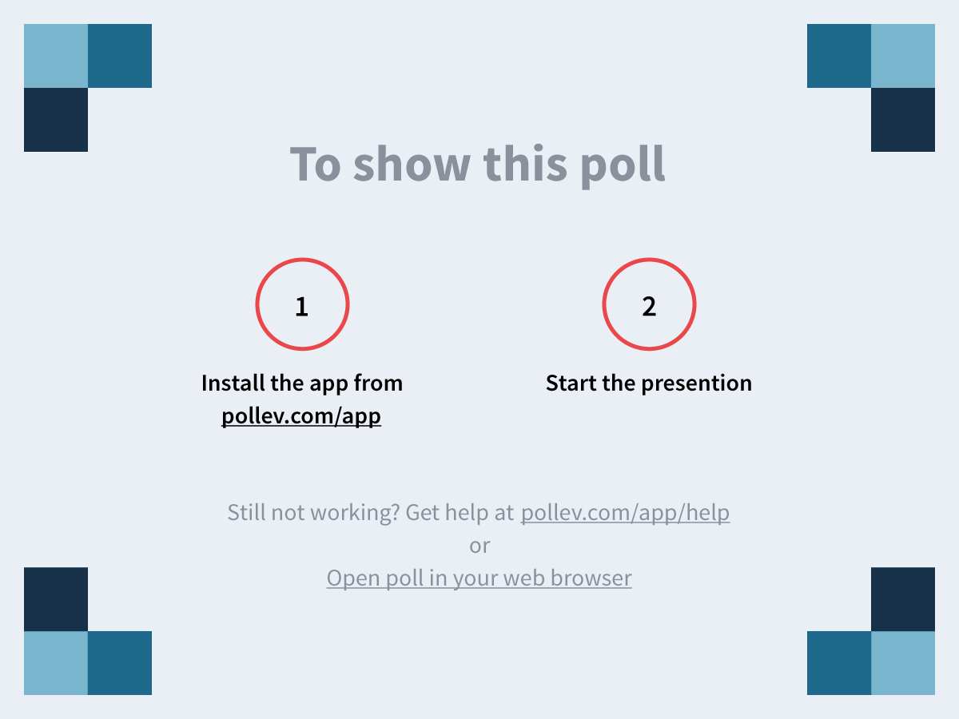
Poll

Slide 3
Panelists: Melissa Green
Melissa Green
Academic Technologies Instruction Librarian
The University of Alabama
@mbfortson
http://bit.ly/ACRL2017Horizon #ACRL2017Horizon

Slide 4
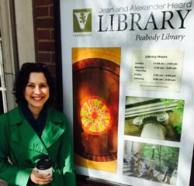
Panelists: Melissa Mallon
Melissa Mallon
Director of Peabody Library/Director of Liaison & Instruction Services
Vanderbilt University Libraries
@librarianliss
http://bit.ly/ACRL2017Horizon #ACRL2017Horizon

Slide 5
Panelists: Rachel Thompson
Rachel Thompson
Director of Emerging Technology and Accessibility
The University of Alabama
@rshuttle
http://bit.ly/ACRL2017Horizon #ACRL2017Horizon

Slide 6
Panel format
The NMC Horizon Report > 2017 Library Edition
Six important technological developments
What they are
Potential to enhance accessibility and learning
Potential to diminish accessibility and learning
http://bit.ly/ACRL2017Horizon #ACRL2017Horizon

Slide 7
Engage with us
Twitter hashtag: #ACRL2017Horizon
Google Doc: http://bit.ly/ACRL2017Horizon
Resources: https://accessibility.ua.edu/acrl/
Poll: https://pollev.com/melissamallon
http://bit.ly/ACRL2017Horizon #ACRL2017Horizon

Slide 8
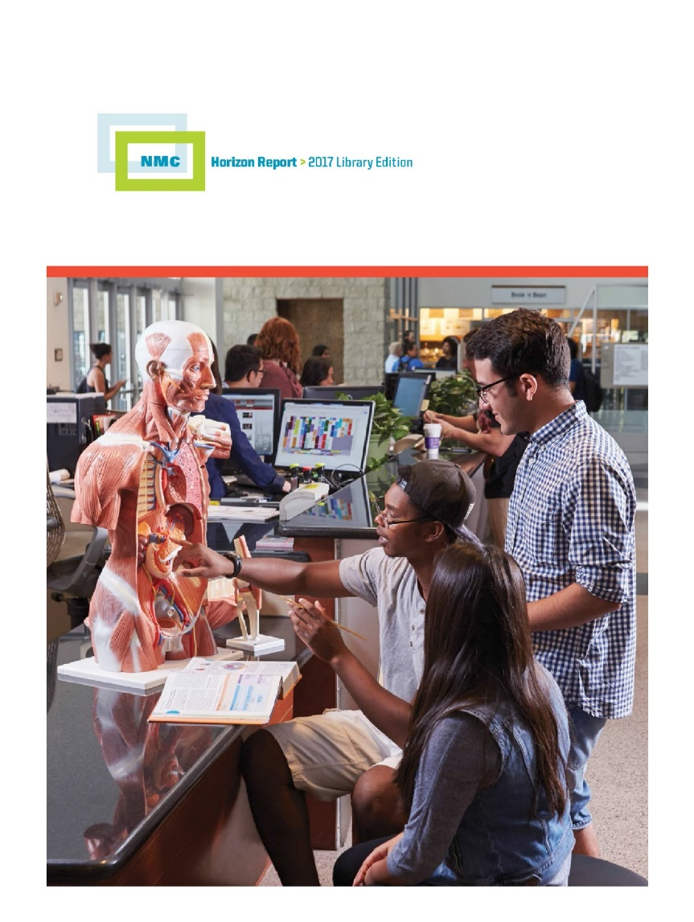
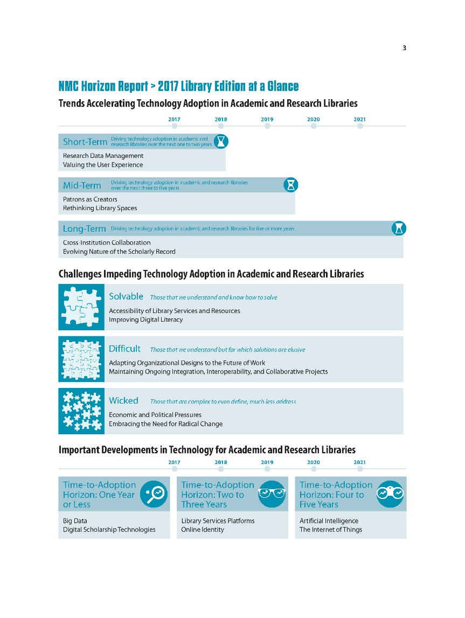
The NMC Horizon Report: 2017 Library Edition

Slide 9
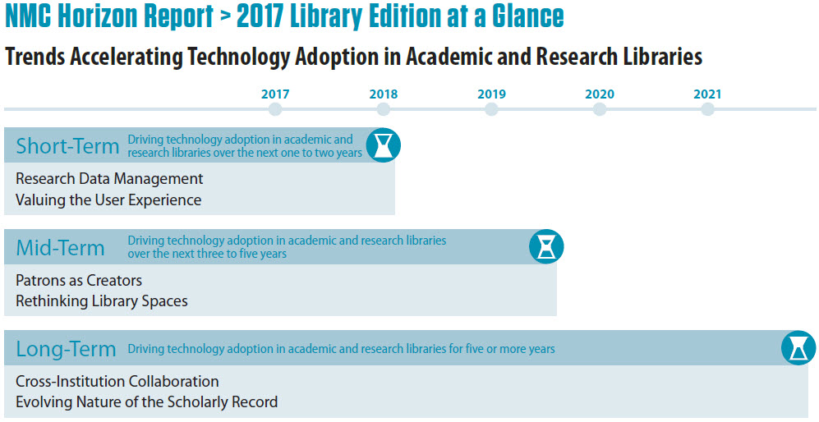
Trends

Slide 10
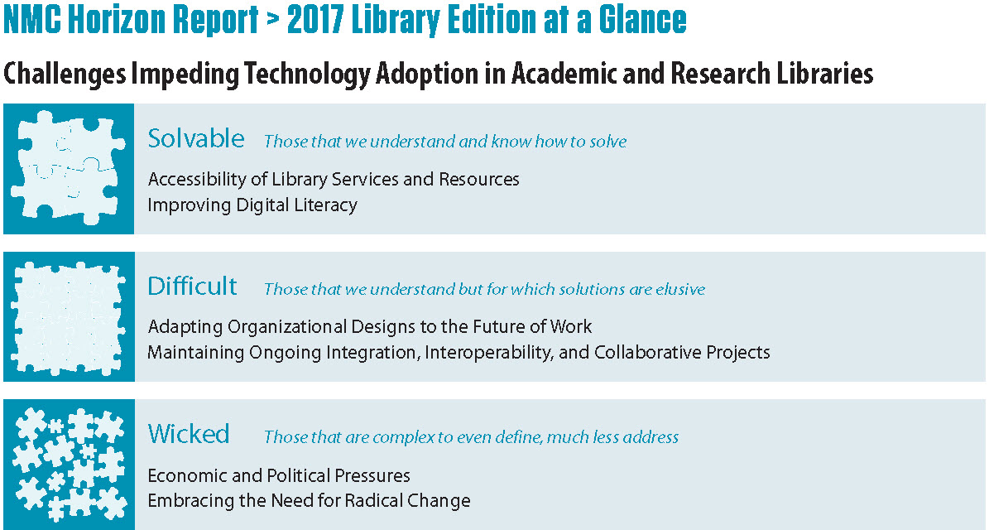
Challenges

Slide 11
Developments

Slide 12
Expanding Access and Convenience

Slide 13
Solvable Challenge: Accessibility of Library Services & Resources
New obstacles surfacing as technology changes the way we access information
Growing accessibility focus impacts required skills
Need to implement technologies and learning resources with diverse needs in mind
Incorporation of universal design principles can improve user experience for all
http://bit.ly/ACRL2017Horizon #ACRL2017Horizon

Slide 14
Solvable Challenge: Accessibility of Library Services & Resources
Additional strategies
Usability testing
Digital accessibility audits
Learning technologies accessibility standards
Integrating student voices will be paramount
Libraries can pave the way
http://bit.ly/ACRL2017Horizon #ACRL2017Horizon

Slide 15
Important Developments

Slide 16
Poll Results
Poll 2

Slide 17
Near-term
Time to adoption horizon: one year or less

Slide 18
Big Data
Growing, massive amounts of data generated by our behaviors and actions
Increasingly easy to analyze and identify patterns that may have otherwise gone undetected
With the complexity surrounding such large, diverse sets of data, displaying the information in a digestible format is crucial to its success
http://bit.ly/ACRL2017Horizon #ACRL2017Horizon

Slide 19
Big Data
Impact on teaching and learning
Mining our institutional data to examine student behavior and predict student needs
New avenues for research in many fields
New ways to make big data understandable and meaningful
Questions regarding privacy and security
How dirty is our data?
http://bit.ly/ACRL2017Horizon #ACRL2017Horizon

Slide 20
Big Data
Potential to diminish accessibility:
Privacy, trust, and stereotyping potential
Increased focus on visual representations of data can exclude some users
Equivalent experience quandary for innovative tools without access
http://bit.ly/ACRL2017Horizon #ACRL2017Horizon

Slide 21
Big Data
Potential to enhance accessibility:
Offers inroads to explore other ways to perceive and comprehend data relationships.
Describler screen reader
Sonification of data and auditory graphs
Reaching visual learners
Data analytics may show areas of concern and opportunity
Digitization projects offer unprecedented access to materials
http://bit.ly/ACRL2017Horizon #ACRL2017Horizon

Slide 22
Digital Scholarship Technologies
The expansion of scholarship to the digital realm, where the components of scholarship are digital or accomplished digitally, including evidence, research, methods of inquiry, creation/authoring, editing, dissemination, and curation.
Includes use of and study of digital media, including social media.
http://bit.ly/ACRL2017Horizon #ACRL2017Horizon

Slide 23
Digital Scholarship Technologies
Impact on Teaching and Learning:
Evolution of the academy? Acceptance of diverse scholarship, communication, publication, and research.
New areas of inquiry and frontiers for research:
Social media as evidence:
No Homophobes (trigger warning)
Twitter data research
Potential for near-immediate access to source and primary documents
New tools available frequently, some more reliable and useful than others
http://bit.ly/ACRL2017Horizon #ACRL2017Horizon

Slide 24
Digital Scholarship Technologies
Potential to diminish accessibility
Access for all is crucial in the tool development, usage, and output
Prezi
"To conclude, the entire world seems to believe that blind people make terrific musicians with the exception of the companies that make technology related to music who seem to ignore our needs as a matter of course." - Chris Hofstader
What could we do if we tried to make digital scholarship (new and existing) accessible to all?
http://bit.ly/ACRL2017Horizon #ACRL2017Horizon

Slide 25
Digital Scholarship Technologies
Potential to enhance accessibility
If tools to create and engage with digital scholarship are created with accessibility in mind, everyone benefits.
Gesture Input for Accessible STEM
Methods of envisioning data that can activate the creativity of students who don't thrive in traditional classroom activities
Learning communities that can unite PwD in ways difficult to achieve with physical, face-to-face campus
#cripthevote Twitter chat Disability Visibility Project
http://bit.ly/ACRL2017Horizon #ACRL2017Horizon

Slide 26
Mid-term
Time to adoption horizon: two to three years

Slide 27
Library Services Platforms
Next-gen of integrated library systems are referred to as “library service platforms” (LSPs), coined by Marshall Breeding
Shift to discovery interfaces, cloud-based platforms and integrated resource management
http://bit.ly/ACRL2017Horizon #ACRL2017Horizon

Slide 28
Library Services Platforms
Impact on teaching and learning
Cloud-based LSPs
Curriculum driven use of library materials
Faculty looking beyond the LMS
API integration
Enterprise platform in SirsiDynix’s BlueCloud LSP
http://bit.ly/ACRL2017Horizon #ACRL2017Horizon

Slide 29
Library Services Platforms
Potential to enhance accessibility
The Folio Project - https://www.folio.org/
Google Impact Challenge - https://www.google.co.uk/about/values-in-action/impact-challenge/
http://bit.ly/ACRL2017Horizon #ACRL2017Horizon

Slide 30
Library Services Platforms
Potential to diminish accessibility
Lack of interoperability
Vendor swapping
Need for vendors to acknowledge UDL
http://bit.ly/ACRL2017Horizon #ACRL2017Horizon

Slide 31
Online Identity
Listed as a “social medial technology” in the 2017 Higher Ed Horizon Report, which are classified as ubiquitous, ever-evolving ideas, tools, and platforms.
Spreading digital fluency is a core responsibility. Libraries are well-positioned to lead efforts that develop patrons’ digital citizenship, ensuring mastery of responsible and creative technology use, including online identity, communication etiquette, and rights and responsibilities.
http://bit.ly/ACRL2017Horizon #ACRL2017Horizon

Slide 32
Online Identity
Impact on teaching and learning
Implications for digital literacy
Research & identity management
Single sign-on / user authentication
http://bit.ly/ACRL2017Horizon #ACRL2017Horizon

Slide 33
Online Identity
Potential to enhance accessibility
Creation of avatars or alternate identities
Tracking user data for targeted content
http://bit.ly/ACRL2017Horizon #ACRL2017Horizon

Slide 34
Online Identity
Potential to diminish accessibility
Participatory engagement . . . for some
Password security affected by physical, visual impairments
http://bit.ly/ACRL2017Horizon #ACRL2017Horizon

Slide 35
Far-term
Time to adoption horizon: four to five years

Slide 36
Artificial Intelligence
The design, implementation, and use of programs, machines, and systems that exhibit human intelligence
Voice recognition
Image identification
Natural language processing
Expert systems
Neural networks
Planning
Robotics
Intelligent agents
http://bit.ly/ACRL2017Horizon #ACRL2017Horizon

Slide 37
Artificial Intelligence
Impact on teaching and learning
More sophisticated databases and search engines
Semantic Scholar
Increase in personalization
AI agents/bots
Hugh
Intelligent tutoring
Virtual reality and computer vision for immersive, hands-on learning
Simulations and gamification with rich learning analytics
http://bit.ly/ACRL2017Horizon #ACRL2017Horizon

Slide 38
Artificial Intelligence
Potential to enhance accessibility
Tool for differentiated instruction
Offers ability to create personalized user experiences hat take accessibility needs and preferences into account
May be able to recognize emotions and other non-verbal cues
http://bit.ly/ACRL2017Horizon #ACRL2017Horizon

Slide 39
Artificial Intelligence
Potential to diminish accessibility
Concerns about the accessibility of the technologies themselves
Intelligent tutoring/adaptive learning perhaps not an effective approach for students who don’t test well
Personalization concerns for AT users
http://bit.ly/ACRL2017Horizon #ACRL2017Horizon

Slide 40
The Internet of Things
Network of connected objects that link the physical world with the world of information
http://bit.ly/ACRL2017Horizon #ACRL2017Horizon

Slide 41
The Internet of Things
Impact on teaching and learning
Libraries can use beacons to:
Connect patrons to exhibit information
Provide targeted notifications about events and services based on location in the library
Suggest relevant electronic resources as patrons browse the stacks
Share instructions for technology usage as patrons approach devices
Better understand their patrons
Monitor equipment and environmental conditions
Additional uses outside the library
http://bit.ly/ACRL2017Horizon #ACRL2017Horizon

Slide 42
The Internet of Things
Potential to enhance accessibility
Can be used to create more accessible environments
Beacons can be used to provide audio directions
Sensor-laden gloves could facilitate communication between those who use sign language and those who don’t
Networked sensors could inform drivers of the availability to accessible parking
Can provide notifications about physical space access
Can offer personalized information and resources tailored to accessibility preference or need
http://bit.ly/ACRL2017Horizon #ACRL2017Horizon

Slide 43
The Internet of Things
Potential to diminish accessibility
Privacy concerns
“Over personalization”
Digital Divide
“Smart” technologies may not be so smart or may not play nicely with assistive technology
http://bit.ly/ACRL2017Horizon #ACRL2017Horizon

Slide 44
Think-Pair-Share
Think of a library and/or learning technology at your institution and its potential to enhance and diminish accessibility.
Pair with the person next to you to discuss your ideas.
Share your thoughts with the group by reporting back on your discussion.
http://bit.ly/ACRL2017Horizon #ACRL2017Horizon

Slide 45
Continue the conversation
Twitter hashtag: #ACRL2017Horizon
Google Doc: http://bit.ly/ACRL2017Horizon
Resources:
Melissa Green
@mbfortson
Melissa Mallon
@librarianliss
Rachel Thompson
@rshuttle
http://bit.ly/ACRL2017Horizon #ACRL2017Horizon

